Slide 1
Software Engineering
Lecture 10

Slide 2
Lectures | Topics
1 | Introduction to Software Engineering
2 | Software Development Process (SDLC Activities) SDLC Activity: Specification or Requirement Engineering SDLC Activity: System Modeling/Design SDLC Activity: Implementation SDLC Activity: Testing SDLC Activity: Evolution (-) SDLC Activity: Deployment/Installation SDLC Activity: Maintenance (-)
3 | SDLC Activity: Requirement Engineering Requirement Elicitation Requirement Analysis and Management Requirement Validation
4, 5, 6,7 | SDLC Activity: System Modeling/Design
8 | SDLC Activity: Testing (White Box Testing – Focus)
9 | SDLC Activity: Testing (Black Box Testing – Focus)
10 | System Development Strategy
11
12

Slide 3
Development Strategy - Overview
1.0
1.1
Previously:
Just a few years ago, a typical company either developed software itself, purchased a software package (which might need some modification), or hired consultants or outside resources to perform the work.
Now:
Today, a company has many more choices, including application service providers, Web-hosted software options, and third party firms that offer a variety of enterprise-wide software solutions.
Things to consider for choosing system development:
Selecting the best development path is an important decision that requires companies to consider three key topics:
  software outsourcing options
  In-house software development alternatives.
1.2
1.3

Slide 4
The Impact of Internet
2.0
The Internet has triggered enormous changes in business methods and operations, and software acquisition is no exception.
Information Systems are no longer the system just bought to store data. It needs to do much more to generate/impact to generate revenue.

Slide 5
Traditional VS Modern Approach
2.1
Traditional Approach
Systems design is influenced by compatibility issues, including existing hardware and software platforms and legacy system requirements.
Modern Approach
Internet-based development treats the Web as the platform, rather than just a communication channel.
Systems are designed to run on intranet and extranet.
Development typically follows one of three main paths: in-house development, purchase of a software package.
Web-based systems are easily scalable, and can run on multiple hardware environments.
Large firms tend to deploy Web-based systems as enterprise-wide software solutions for applications such as customer relationship management, order processing, and materials management.
Web-based software treats the software application as a service (SAAS) that is less dependent on desktop computing power and resources.
Systems often utilize Internet links and resources, but Web-based features are treated as enhancements rather than core elements of the design.
Modern Approach is the result of Internet

Slide 6
Software as a Service (SaaS)
2.2
Traditional Way
NOW !!
How do you purchase software ?
When companies acquire Web-based software as a service rather than a product they purchase,
Have the vendor install, configure, and maintain the system
Paying agreed-upon fees.
Discuss NEED
DEFINE which software you NEED
SELECT vendor/in house development to DEVELOP your system
DEPLOY and use

Slide 7
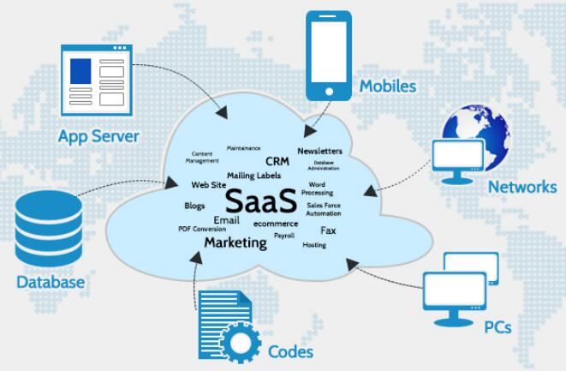
Software as a Service (SaaS)
2.2
SaaS applications are called web-based software, on-demand software, or hosted software

Slide 8
Software as a Service (SaaS)
2.2
2.2.1
Cloud Based App:
Software as a service (SaaS) allows users to connect to and use cloud-based apps over the Internet. Common examples are email, calendaring and office tools (such as Microsoft Office 365).
Pay As You Go:
SaaS provides a complete software solution which you purchase on a pay-as-you-go basis from a cloud service provider. You pay only for the amount of service you have used for.
Minimum Upfront Cost:
SaaS allows your organization to get quickly up and running with an app at minimal upfront cost.
2.2.2
2.2.3

Slide 9
Advantages of Software as a Service (SaaS)
2.3
Gain access to sophisticated applications
SaaS makes even sophisticated enterprise applications, such as ERP and CRM, affordable for organizations
Pay only for what you use
You also save money because the SaaS service automatically scales up and down according to the level of usage.
Use free client software
Users can run most SaaS apps directly from their web browser (which is free client software) without needing to download and install any software, although some apps require plugins
Mobilize your workforce easily
SaaS makes it easy to “mobilize” your workforce because users can access SaaS apps and data from any Internet-connected computer or mobile device
Access app data from anywhere
With data stored in the cloud, users can access their information from any Internet-connected computer or mobile device

Slide 10
Outsourcing
3.0
Definition
Outsourcing is the transfer of information systems development, operation, or maintenance to an outside firm that provides these services, for a fee, on a temporary or long-term basis.
Outsourcing can refer to relatively minor programming tasks, the rental of software from a service provider, the outsourcing of a basic business process (often called business process outsourcing, or BPO), or the handling of a company’s entire IT function.

Slide 11
Outsourcing
3.0
3.1
ASP : Application Service Provider
An application service provider (ASP) is a firm that delivers a software application, or provide access to an application, by charging a usage or subscription fee. It rents an operational package to the customer.
ASPs typically provide commercially available software such as databases and accounting packages. If a company uses an ASP to supply a data management package, for example, the company does not have to design, develop, implement, or maintain the package themselves.
Basically, vendor are providing software via Cloud

Slide 12
Outsourcing
3.0
3.2
Purpose of Outsourcing
Reduce costs and Improve Efficiency
Is a business practice used by companies to reduce costs or improve efficiency by shifting tasks, operations, jobs or processes to an external contracted third party for a significant period of time.
Note: The functions that are contracted out can be performed by the third party either onsite or offsite of the business.

Slide 13
Outsourcing
3.0
Purpose of outsourcing: WHY DO IT ??
In terms of staying in competition
If you deprive yourself of outsourcing and your competitors do, you're putting yourself out of business.
India is the one of the greatest beneficiary of IT outsourcing destination (mostly softwares)

Slide 14
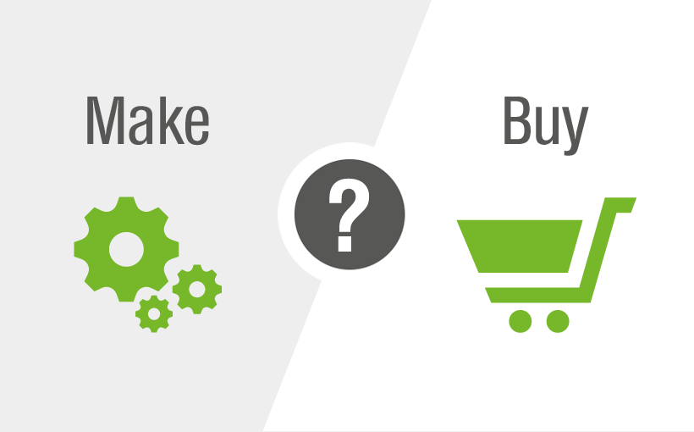
Software: Make it or Buy it?
4.0

Slide 15
Make or Buy
4.0
Make
Availability
In House Experience
Buy
Legal Issues
Risk
Costs
Strategic

Slide 16
Make or Buy
4.0
Make
Satisfy unique business requirements
Minimize changes in business procedures. Requires less time to implement and policies
Buy
Lower costs
Requires less time to implement
Meet constraints of existing systems/technology
Develop internal resources and capabilities
Satisfy unique security requirements
Proven reliability and performance benchmarks
Requires less technical development staff
Future upgrades provided by the vendor
Obtain input from other companies

Slide 17
Development Methodologies
5.0
What clients PREFER ?
Clients prefer to CHANGE requirements without COST and TIME unchanged, this is why agile is methods are popular

Slide 18
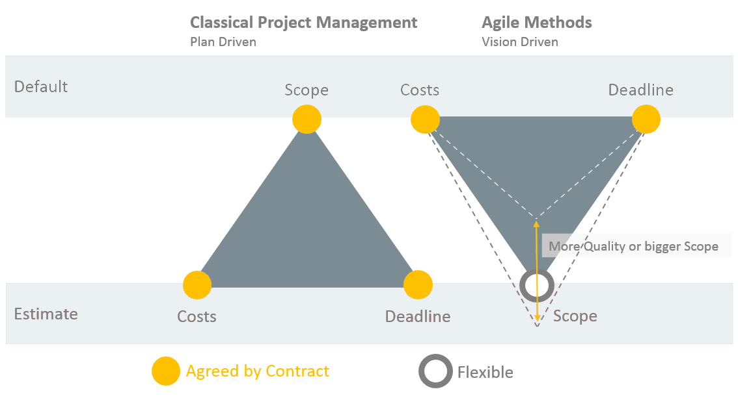
Development Methodologies
5.0

Slide 19
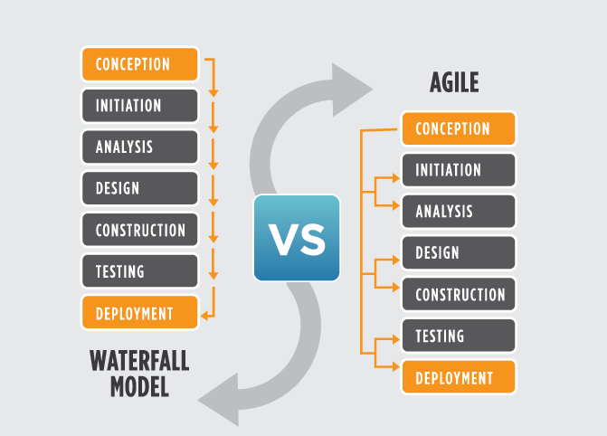
Development Methodologies
5.0
Classical and Agile
5.1
5.2

Slide 20
Development Methodologies
5.0
So Finally, What clients PREFER ?
Agile
SCRUM
Traditional
Waterfall
XP
SSADM

Slide 21
Agile Framework - SCRUM
5.2.1
Based on continuous feedback
Getting product faster in the market since market is changing very rapidly
Focus on
  Individuals and interactions over processes and tools
  Working software over comprehensive documentation
  Customer collaboration over contract negotiations
  Responding change over following a plan
Scrum is modern approach because it follows all the guideline provided by the Manifesto for Agile software Development
  https://agilemanifesto.org/

Slide 22
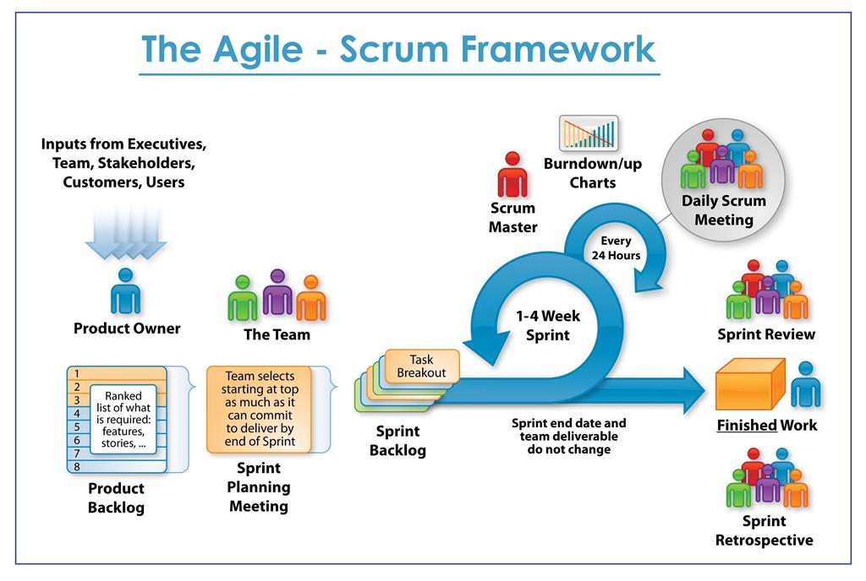

Slide 23
Scrum - Terminology
5.2.1
Roles
  Product Owner, Team, Scrum Master
Scrum List
  Product Backlog (User Stories, Requirements, Bugs), Basically an overall requirements
  Sprint Backlog (Selected requirement from a product backlog for a particular sprint)
Scrum Board
  To do, in progress, done
Meetings
  Sprint Planning (once for a given sprint)
  Standup (Daily meeting: is everything going as per plan, any roadblocks?)
  Review (As per needed, receiving feedback)
  Retrospect (review the process itself)

Slide 24
Development Methodologies
5.0
When to choose what methodology?
5.3
Agile
Customer Interaction
Traditional
Contracts
High Performance Teams
Processes
Documentation
Project Plans
Iterative Development
Adaptability/Flexibility

Slide 25
Trends
6.0
Understanding trend is important because it determines, what development paths to be taken
6.1
Cloud Computing
Cloud Computing is the delivery of computing services—servers, storage, databases, networking, software, analytics and more—over the Internet (“the cloud”).
Companies offering these computing services are called cloud providers and typically charge for cloud computing services based on usage, similar to how you are billed for water or electricity at home.

Slide 26
Trends
6.1
Cloud Computing - Types
IaaS
Infrastructure as a Service
You rent IT infrastructure—servers and virtual machines (VMs), storage, networks, operating systems—from a cloud provider on a pay-as-you-go basis
PaaS
Platform as a Service
Supply an on-demand environment for developing, testing, delivering and managing software applications
SaaS
Software as a Service
Method for delivering software applications over the Internet, on demand and typically on a subscription basis

Slide 27
Trends
6.2
Big Data
Extremely large data sets that may be analyzed computationally to reveal patterns, trends, and associations, especially relating to human behavior and interactions. (BI applications)
Concept Involved: Data Mining, AI applications
Notes:
Cannot process with traditional techniques / Traditional approach (computer resource)
Size of 100mb is big data for email (depending on context)
How does fb, twitter like things process data
Storing and processing becomes difficult
Hadoop comes into action

Slide 28



Trends
6.2
Big Data
BIG DATA
ANALYSIS
INSIGHTS

Slide 29
Trends
6.3
IoT (Internet of Things)
The Internet of Things (IoT) is a system of interrelated computing devices, mechanical and digital machines, objects, animals or people that are provided with unique identifiers and the ability to transfer data over a network without requiring human-to-human or human-to-computer interaction.
Notes:
Tesla car, data collection
Sensor is main things

Slide 30
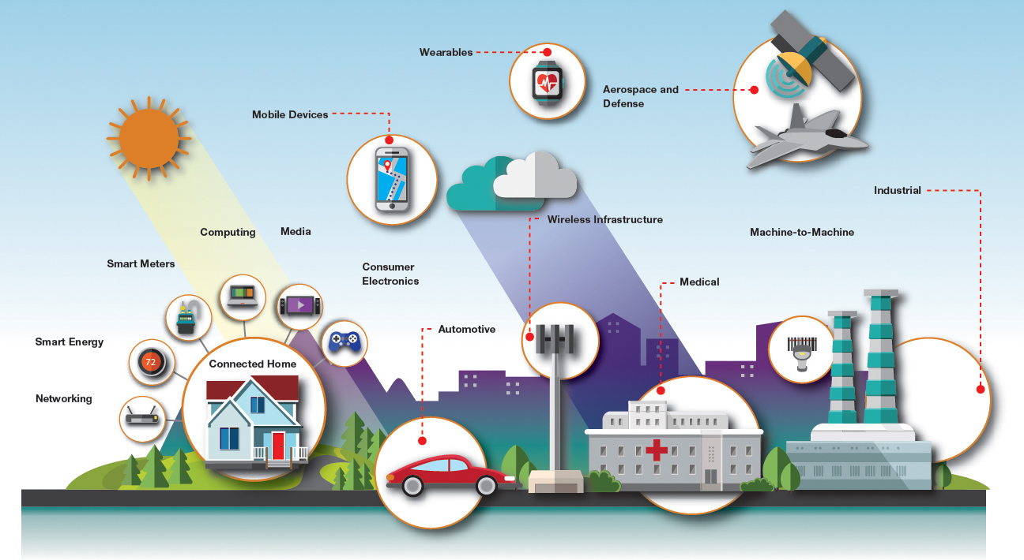
Trends
IoT (Internet of Things)
6.3
https://www.youtube.com/watch?v=QSIPNhOiMoE
https://www.youtube.com/watch?v=LlhmzVL5bm8

Slide 31
Trends
6.4
Block Chain
Block chain is the world's leading software platform for digital assets. Offering the largest production block chain platform in the world, we are using new technology to build a radically better financial system
Example: Bitcoin

Slide 32
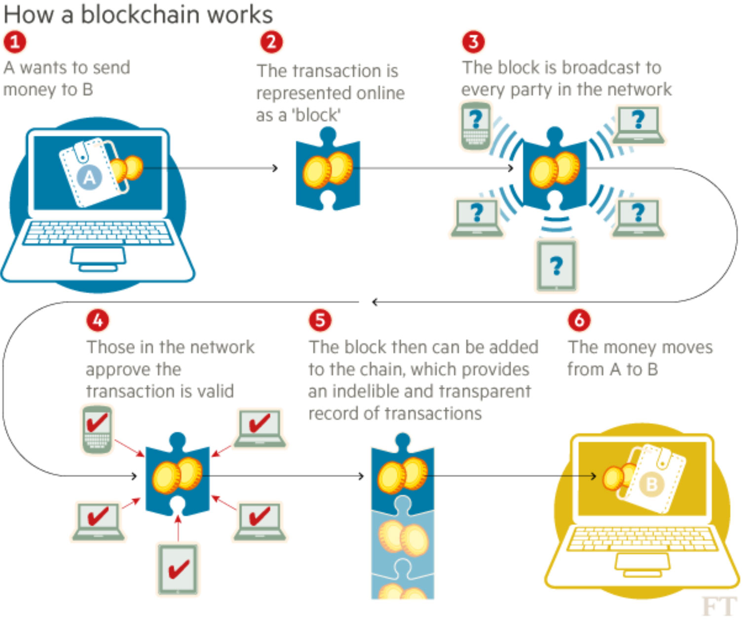
Trends
6.4
Block Chain

